Slide 1
Welcome to Farm to Table! You’re here and that’s what I love about you!!
Take a name tag from the front table. Take it to where you wish to sit today. Fold it in half with the writing on the inside
Write your name on the front and back. Decorate it to represent you!

Slide 2
Mrs. Gray

Slide 3
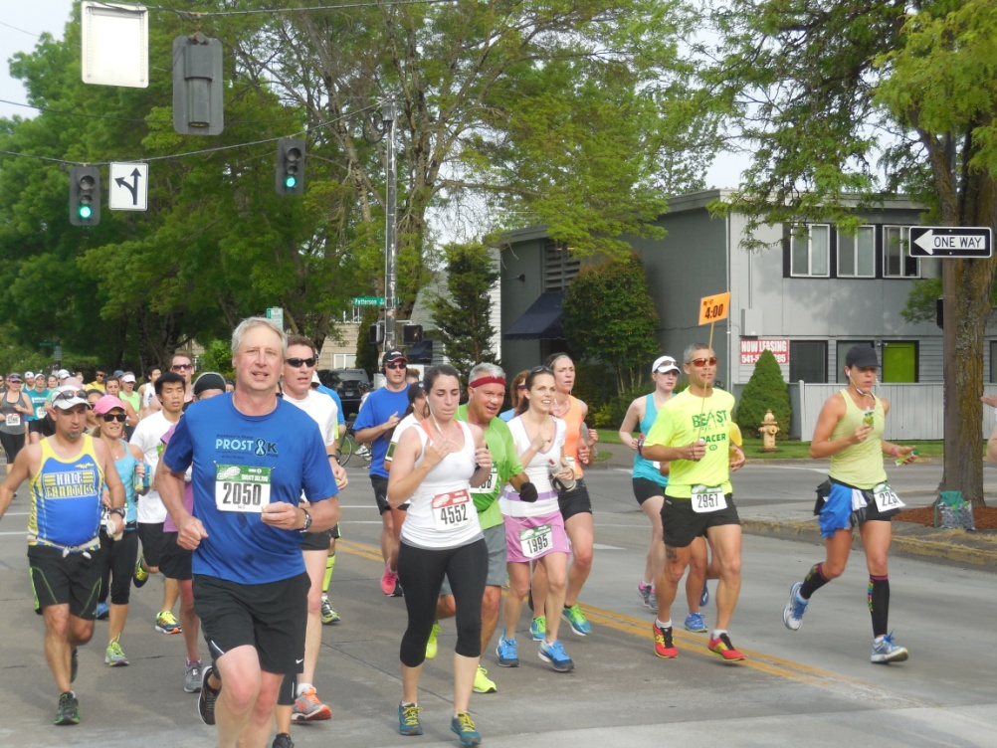
What do you know about Mrs. Gray?
Married 36 years to Dan who just retired this year

Slide 4
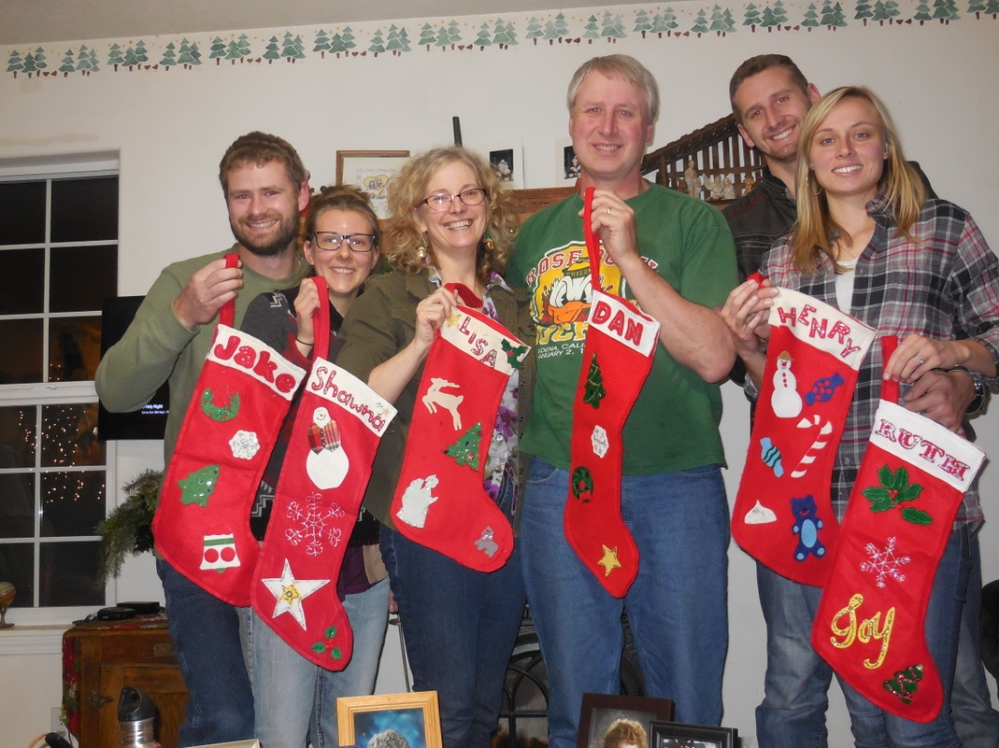
Two children, both boys (Jacob and Henry) aged 28 and 30
Two “bonus daughters: called Shawna and Ruth

Slide 5
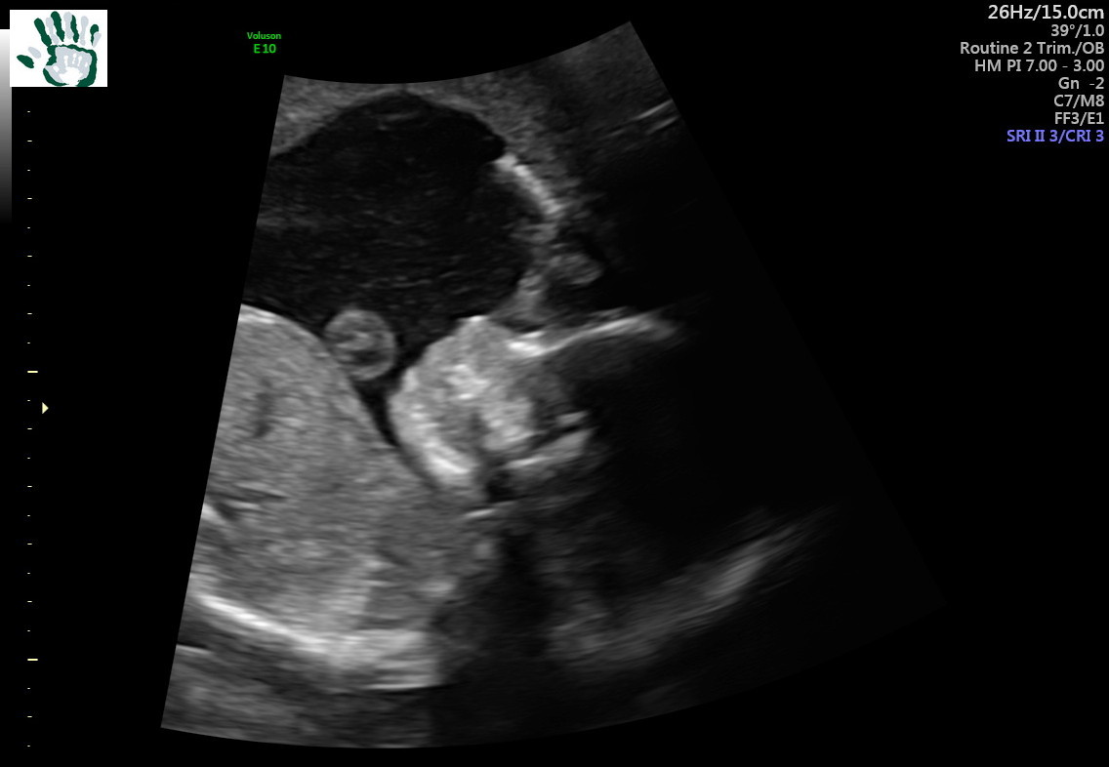
First grandchild due November 16 (Benjamin Lloyd)

Slide 6
Hobbies: gardening, reading, paper and other crafts, knitting and crocheting, hiking

Slide 7
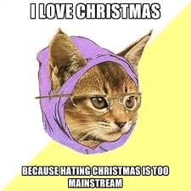
I LOVE Christmas

Slide 8
Now it’s time to take some notes. There will be a quiz.

Slide 9
What to bring to class
Paper
Writing instrument
Planner
Necessary supplies for current work
Your brain
Your best attitude

Slide 10
I have only One Rule!
Be Respectful

Slide 11
In this class we will:
Cook
Garden (when we get our garden back)
Crafts

Slide 12
How many strategies do they try?

Slide 13
And now how many strategies?

Slide 14
Beginning of Class
Come in quietly.
Grab your warm up from the front table if there. Sometimes it will be on the screen.
Be in your seat, with all supplies, ready to work when then bell rings.
Begin work on the warm up quietly when the bell rings.

Slide 15
Seating

Slide 16
Today there is no seating chart.
There will be a seating chart next class. Look for your name tent.
Remain in your seat during warm up.
Remain in your seat during instruction.

Slide 17
Responding to Me
When I need your undivided attention, I will raise my hand and say, “Class.”
Immediately freeze in place.
Turn and face me.
Be ready to listen.
Let’s practice!

Slide 18
Don’t be Tardy (but if you are)

Slide 19
I close the door as the bell rings. If you are outside, you are tardy.
Go to the office and get a tardy slip.
Knock politely on my door.
Hand me the tardy slip
Join class with as little disruption as possible.

Slide 20
Assignment expectations
Make sure the holes are on the left side.
On the right side, put your name, date and assignment
Write neatly.
Use the lines
Show your work.

Slide 21
Turning things in
Sometimes I collect everyone’s paper at once.
Otherwise, do NOT hand them to me. I will set them down and lose them. Really.
Put them in the correct section of the turn in tray. (Behind the label.)

Slide 22
Food, Beverages and Other Distractions

Slide 23
Unless I provide it, there is to be no food in this classroom.
Water bottles (with water only) are allowed. No other beverages.
Cell phones only with permission
If I notice it, it is a distraction and I will do something about it.
No hats, hoods, ear buds.

Slide 24
If you are absent…

Slide 25
Don’t be.
Fill out a absent form, filling in all of the work you missed while you were gone. When it is filled out, I will give you the points you missed.

Slide 27
Language
We will speak respectfully.
If you wouldn’t say something to (or about) your best friend, you aren’t to say it to (or about) yourself or anyone else.
Please use the Lord’s name with care.

Slide 28
End of class
The school has handily supplied a bell to tell me that it’s time to dismiss.
Please stay in your seat until I dismiss you.

Slide 29
Grades

Slide 30
You can earn 5 points per day for
coming in quietly
being in your seat working on the warm up when the bell rings
Having planner filled out with a plan for the class when I come around and check
Talking only to me for the first 5 minutes of class
You can earn 5 more points for using your time in class wisely and respectfully.

Slide 31
